Slide 1
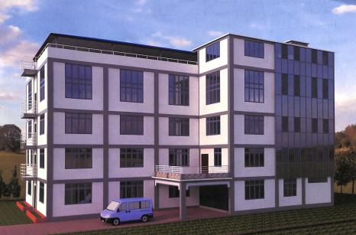

ATRC
Anglican Training
& Resource Center
HOLY CROSS THEOLOGICAL COLLEGE
Church of the province of Myanmar

Slide 2
BACKGROUND
1883: Originated as a school of catechist at St. Michael and all Angels, Kyimyindine
1934: laid foundation of Holy Cross Theological College (HCTC):
1935: HCTC for ordinal training.
1993: Became accredited school of the Association for Theological Education in South-East-Asia (ATESEA) and started conferring B.Th (Bachelor of Theology)
2012: Master of Ministry program was launched

Slide 3
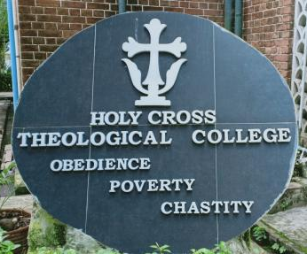
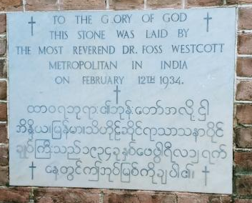
SCHOOL’S MOTTO & FOUNDATION STONE

Slide 4
SIGNIFICANCE OF HCTC
Fully belong to and run by the CPM
The school where most of Myanmar Anglican priests have been trained, equipped, and educated
Anglican oriented curriculum; center for Anglican studies and communion affairs
Very important because it is the Power/knowledge source for Orthodox Christian faith and order in Myanmar
Up to 300 Anglican ministers have been successfully trained

Slide 5
CURRENT STUDENTS LIST,
2019-20 ACADEMIC YEAR
 | Myitkyina | Mandalay | Taungoo | Sittwe | Pathein | Hpa-an | Pyay | Yangon | Total
First Year | 3 |  | 3 | 1 | 1 | 3 | 3 | 1 | 15
Second year | 5 |  | 1 |  | 1 |  |  |  | 7
Third year | 3 |  |  |  |  | 4 | 1 | 1 | 9
Final year | 7 |  | 1 |  |  |  |  | 2 | 10
Special |  |  |  |  |  | 1 |  |  | 1
Total | 18 |  | 5 | 1 | 2 | 7 | 4 | 4 | 42

Slide 6
PROGRAMS OFFERED
B.Th
M.Min
Refresher course
One Year Special course

Slide 7
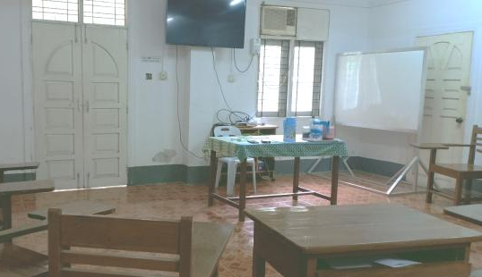
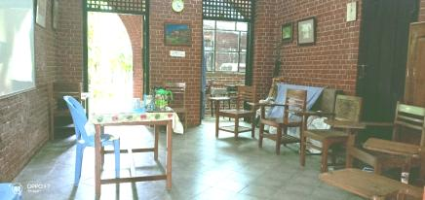
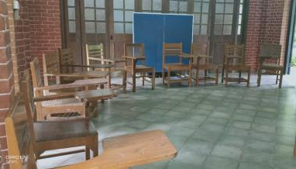
CLASS ROOMS CURRENTLY IN USE

Slide 8
CHALLENGES AND DIFFICULTIES
insufficiency of class rooms (only 2 class rooms in the main building)
Cannot offer B.Th and M.Min simultaneously due to the lack of lecture room
No graduation hall
Hostel for students
To upgrade the library and its facilities
Need a space to run courses for lay and young people
Modernized lecture rooms, offices for faculty, seminar and meeting rooms, apartment for international visiting professor

Slide 9
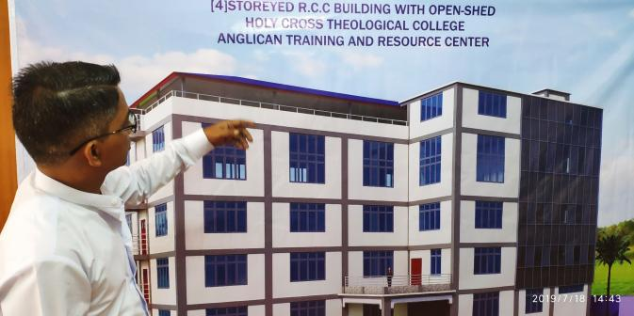
NEW BUILDING (ATRC)
28724.5 square feet

Slide 10
FLOOR PLAN AND ROOMS
Ground Floor…..8 rooms (palor, lecture rooms, small chapel)
1st floor…..8 rooms (lecture rooms)
2nd floor….8 rooms (faculty offices, seminar room, meeting room)
3rd floor…..Library
Top-floor….Multi-purpose hall

Slide 11
WHAT HAVE BEEN DONE UP TO NOW FOR BUILDING ATRC
Paid to contractor 250 lakhs For building permit fees and application processing fees
Paid to contractor kyats 870 (10% of total expense) as a mark of entrusting the building project
Ground-breaking ceremony will be held on September, 11, 2019.

Slide 12
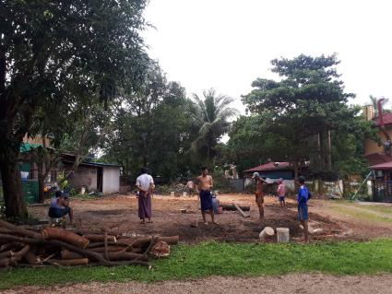
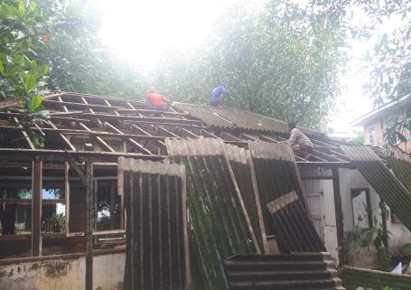
PREPARING FOR GROUNDBREAKING

Slide 13
HOW YOU CAN CONTRIBUTE?
There are various ways to donate.
You can donate expense for a room and it will be named after the donor
You can give for elevator, generator, transformar, furniture, teaching aids, generator, lift, etc.,

Slide 14
TOTAL EXPENSE
Total expense for building only: kyats 8700 lakhs (USD 680000)

Slide 15
ESTIMATED TIME
TO START AND FINISH
Building begins: Oct/Nov 2019
Duration : 1.5 – 2 years
Finishes : Oct 2021

Slide 16
DEAL OVER PAYMENT TO CONTRACTOR
When the…..
Contract is made for the whole project : 10%
Foundation begins : 20%
Foundation is finished : 5%
1st floor slat is done : 10%
2nd floor slat is done : 10%
3rd floor slat is done : 10%
Top floor slat is done : 10%

Slide 17
Open-shed roofing is finished : 4%
Ground-floor bricking/walling finished : 4%
1st floor bricking/walling finished : 4%
2nd floor bricking/walling finished : 4%
3rd floor bricking/walling finished : 4%
Wiring/painting/water pipe finished : 5%

Slide 18
Thanks…

